Slide 1
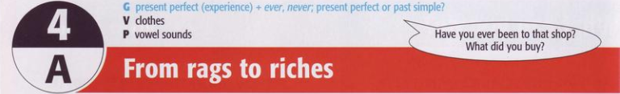
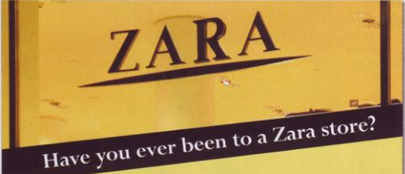

Slide 2
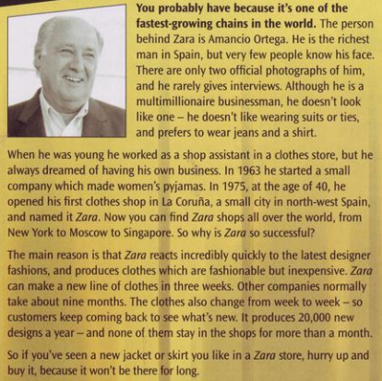
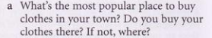
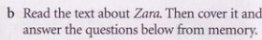
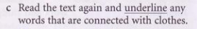
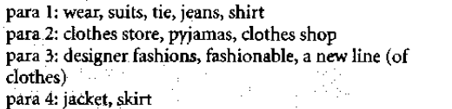

Slide 3
1 Who was Amancio Ortega?
He is the man behind zara shop/ businessman/ the richest man.
2 What is unusual about him?
He is a multimillionaire but he doesn’t like ones.
3 What was his first job?
He was a shop assistant.
4 When dis he opend the first Zara shop?
In 1975
5 Where are there Zara shops now?
All over the world. From Moscow to Singapore.
6 What are the secrets of Zara’s success?
It reacts to the to designer fashion quickly and cheaply, the clothes changes every week, they produce 20,000 new designs a year.

Slide 4
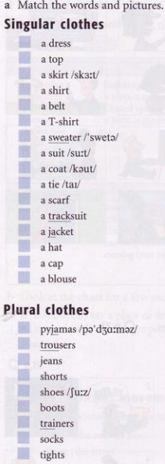
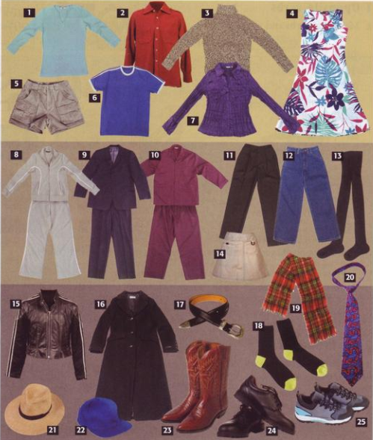
4
1
14
2
17
6
3
9
16
20
19
8
15
21
22
7
10
11
12
5
24
23
25
18
13

Slide 5
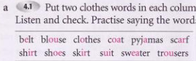
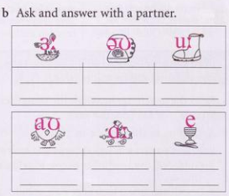
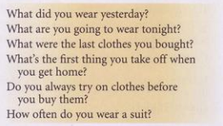

Shirt
Coat
Shoes
Skirt
Clothes
Suit
Blouse
Pyjamas
Belt
Trousers
Scarf
Sweater

Slide 6
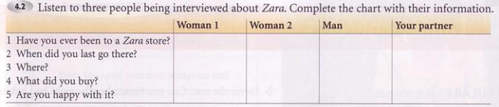
Yes
Yes
Yes (once)
3 weeks ago
Last Saturday
In August
In London
In Paris
Barcelona airport
A white jacket
A scarf
Nothing
Quite happy
Yes

Slide 7
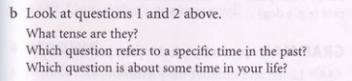
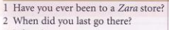
1 is present perfect.
2 is past simple.
2 refers to a specific time in the past.
1 is about some time in your life

Slide 8
Present perfect (experience) + ever, never
Ex: I’ve been to HCM city NOT I’ve been to HCM city last year.
He has seen that film.
My brother has worked abroad.
USES:
We use present perfect to talk about past experiences when you don’t say exactly when they happened.

Slide 9
We often use the present perfect with ever (= in your life until now) and never.
Ever, never is put after the auxiliary verb “have/ has” and before the past participle (main verb).
Ex: Have you ever been to London? No, I’ve never been there.
I’ve never visited Berlin.

Slide 10
NOTES:
Compare the present perfect of go and be.
He’s gone to Paris = He’s in Paris now.
He’s been to Paris = He went to Paris and came back.

Slide 11
Present Perfect or Past Simple
Ex: A Have you ever been to Mexico? B Yes, I have.
A When did you go there? B I went last year.
Conversations often begin in Present Perfect (with a general question) and then change to the past simple ( with questions asking for specific detail, when, where, who with, etc.)
We use Past Simple to ask/say exactly when something happened.

Slide 12
FORMS:
S + have/has + V(-ed/pII)
(’ve/’s)
a. Positive:
Ex: I have been to Da Lat
She has lived in Son Tay for 15 years.
He has seen that film 3 times.
Lưu ý: S = I/ We/ You/ They + have
S = He/ She/ It + has

Slide 13
b. Negative:
S + have not/has not + V(-ed/pII)
(= haven’t/hasn’t )
Ex: I haven’t been to Da Lat.
She hasn’t finished her work yet.

Slide 14
Have/Has + S + V(-ed/pII)?
Yes, S + have/ has
No, S + haven’t/hasn’t
c. Yes/No questions:
Ex: - Have you been to Da Lat?
Yes, I have /No, I haven’t
- Has she finished her work?
Yes, she has /No, she hasn’t

Slide 15
WH-questions:
Wh- + have /has + S + V(-ed/pII)?
S + have/has + V(-ed/pII).
Ex: - Where have you been to?
I have been to Da Lat.
- How many times have you been there?
Three times.
- How many years has she lived in SonTay?
She has lived in Son Tay for 15 years

Slide 16
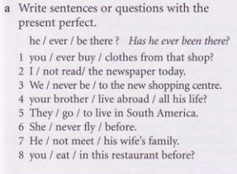
1 Have you ever bought clothes from that shop?
2 I haven’t read the newspaper today.
3 We have never been to the new shopping centre.
4 Has your brother lived abroad all his life?
5 They’ve gone to live in South America.
6 She’s never flown before.
7 He hasn’t met his wife’s family.
8 Have you eaten in this resraurant before?

Slide 17
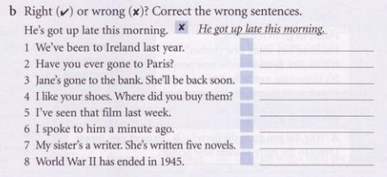
x
We went to Ireland last year.
x
Have you ever been to Paris?
v
v
x
I saw that film last week.
v
v
X
World War II ended in 1945

Slide 18
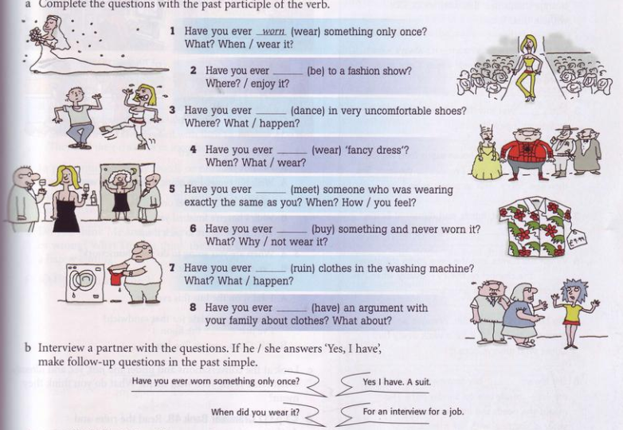
been
danced
worn
met
bought
ruined
had

Slide 19
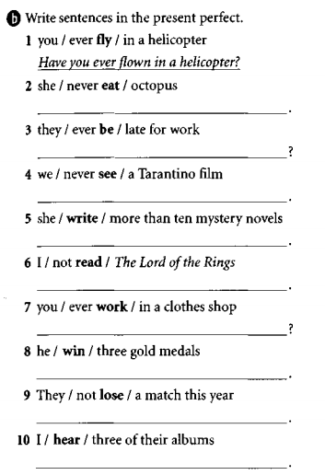
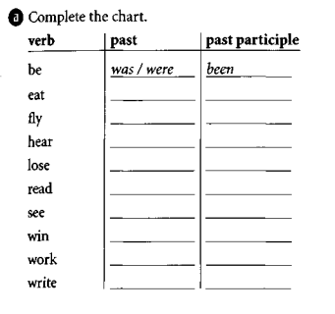
Exercises:
She’s never eaten octopus.
Have they ever been late for work?
ate
eaten
flew
flown
We’ve never seen a Tarantino film
heard
heard
She’s written more than ten mystery novels.
lost
lost
read
read
I haven’t read The Lord of the Rings
saw
seen
Have you ever worked in a clothe shop?
won
won
worked
worked
He’s gone three gold metals
wrote
written
They haven’t lost a match this year.
I’ve heard three of their albums.

Slide 20
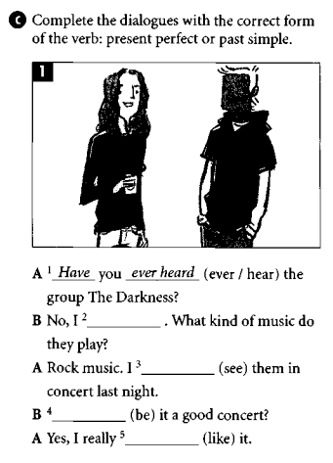
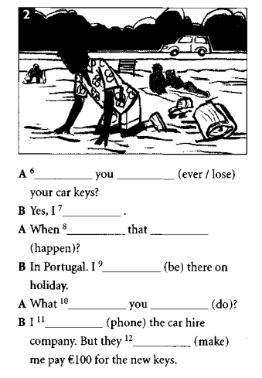
Have
ever lost
have
did
happed
haven’t
was
saw
Was
phoned
liked
made

